Slide 1
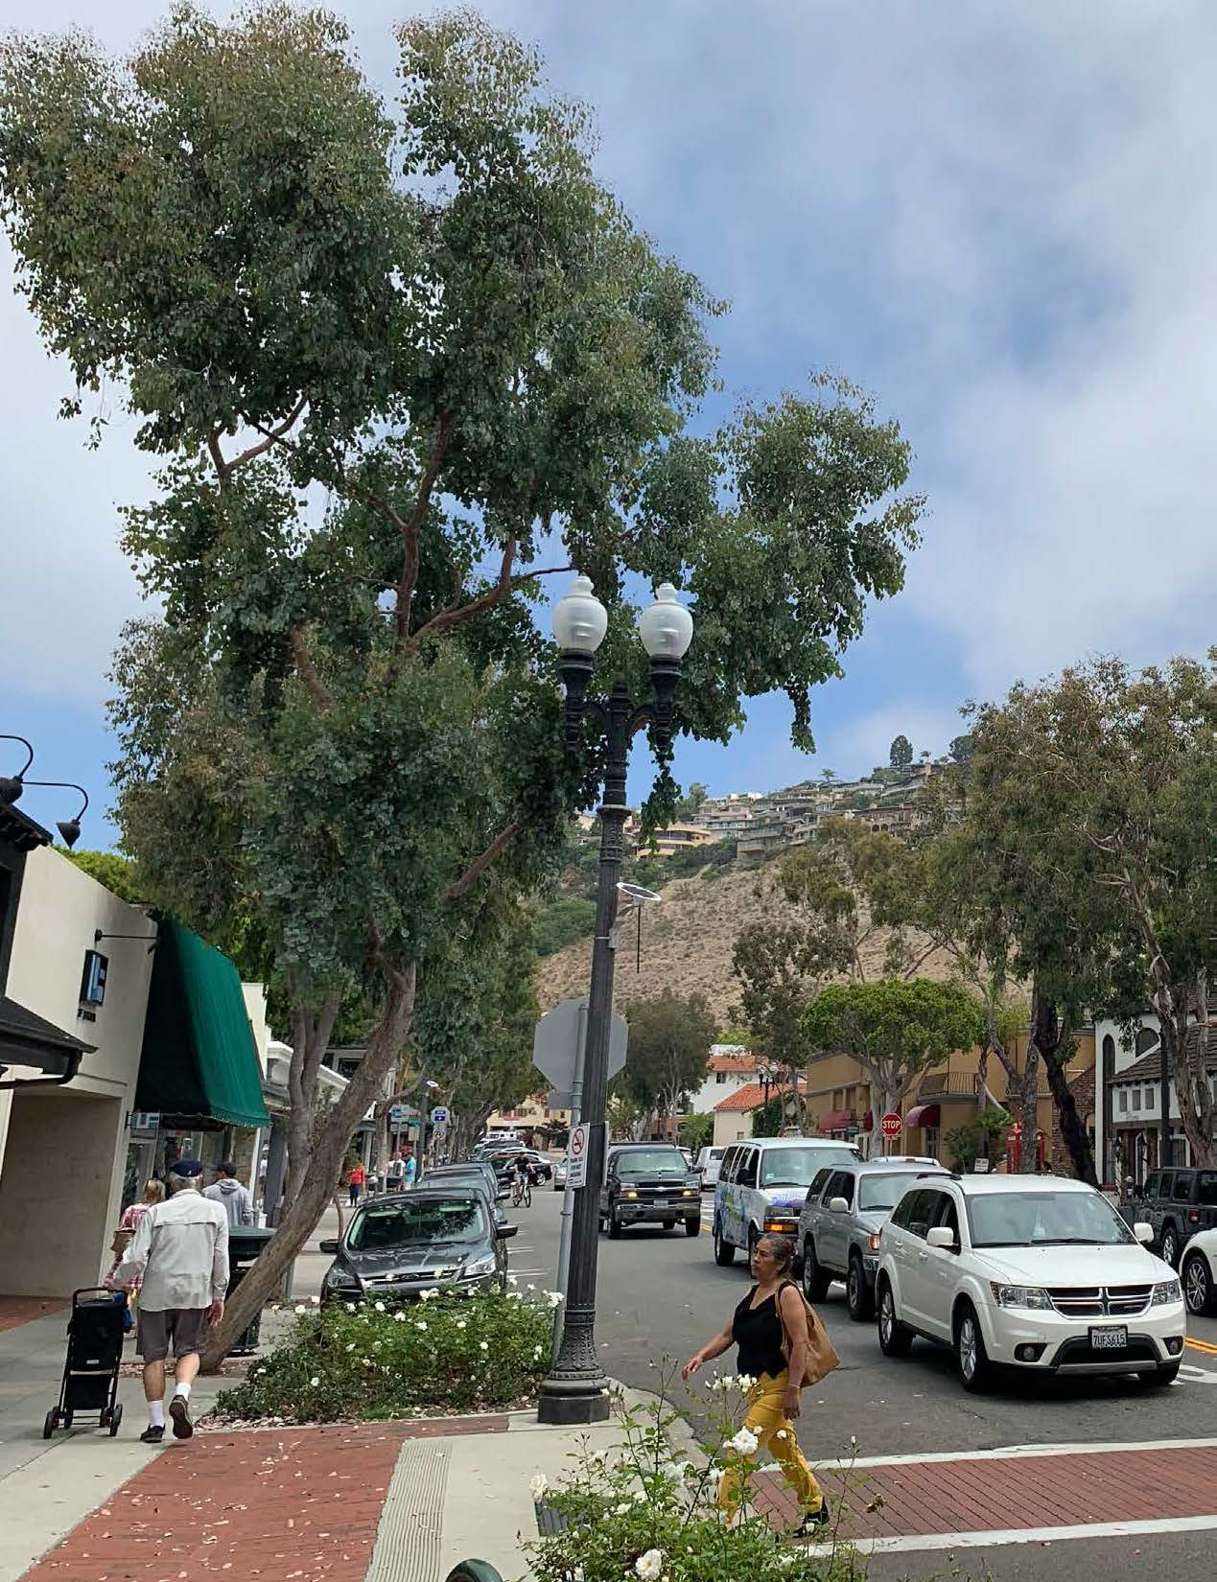
DOWNTOWN
ACTION
PLAN
Are these concepts true and do they reflect a respect for the character of the Laguna we love?

Slide 2
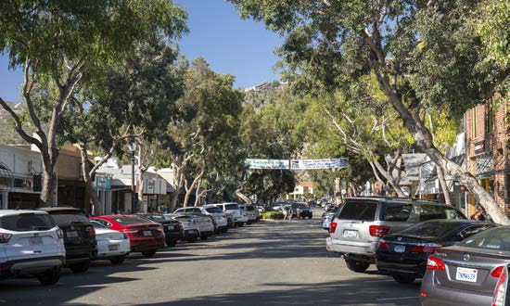
“The trees along Forest provide no shade” Really?
p. 11, staff report

Slide 3
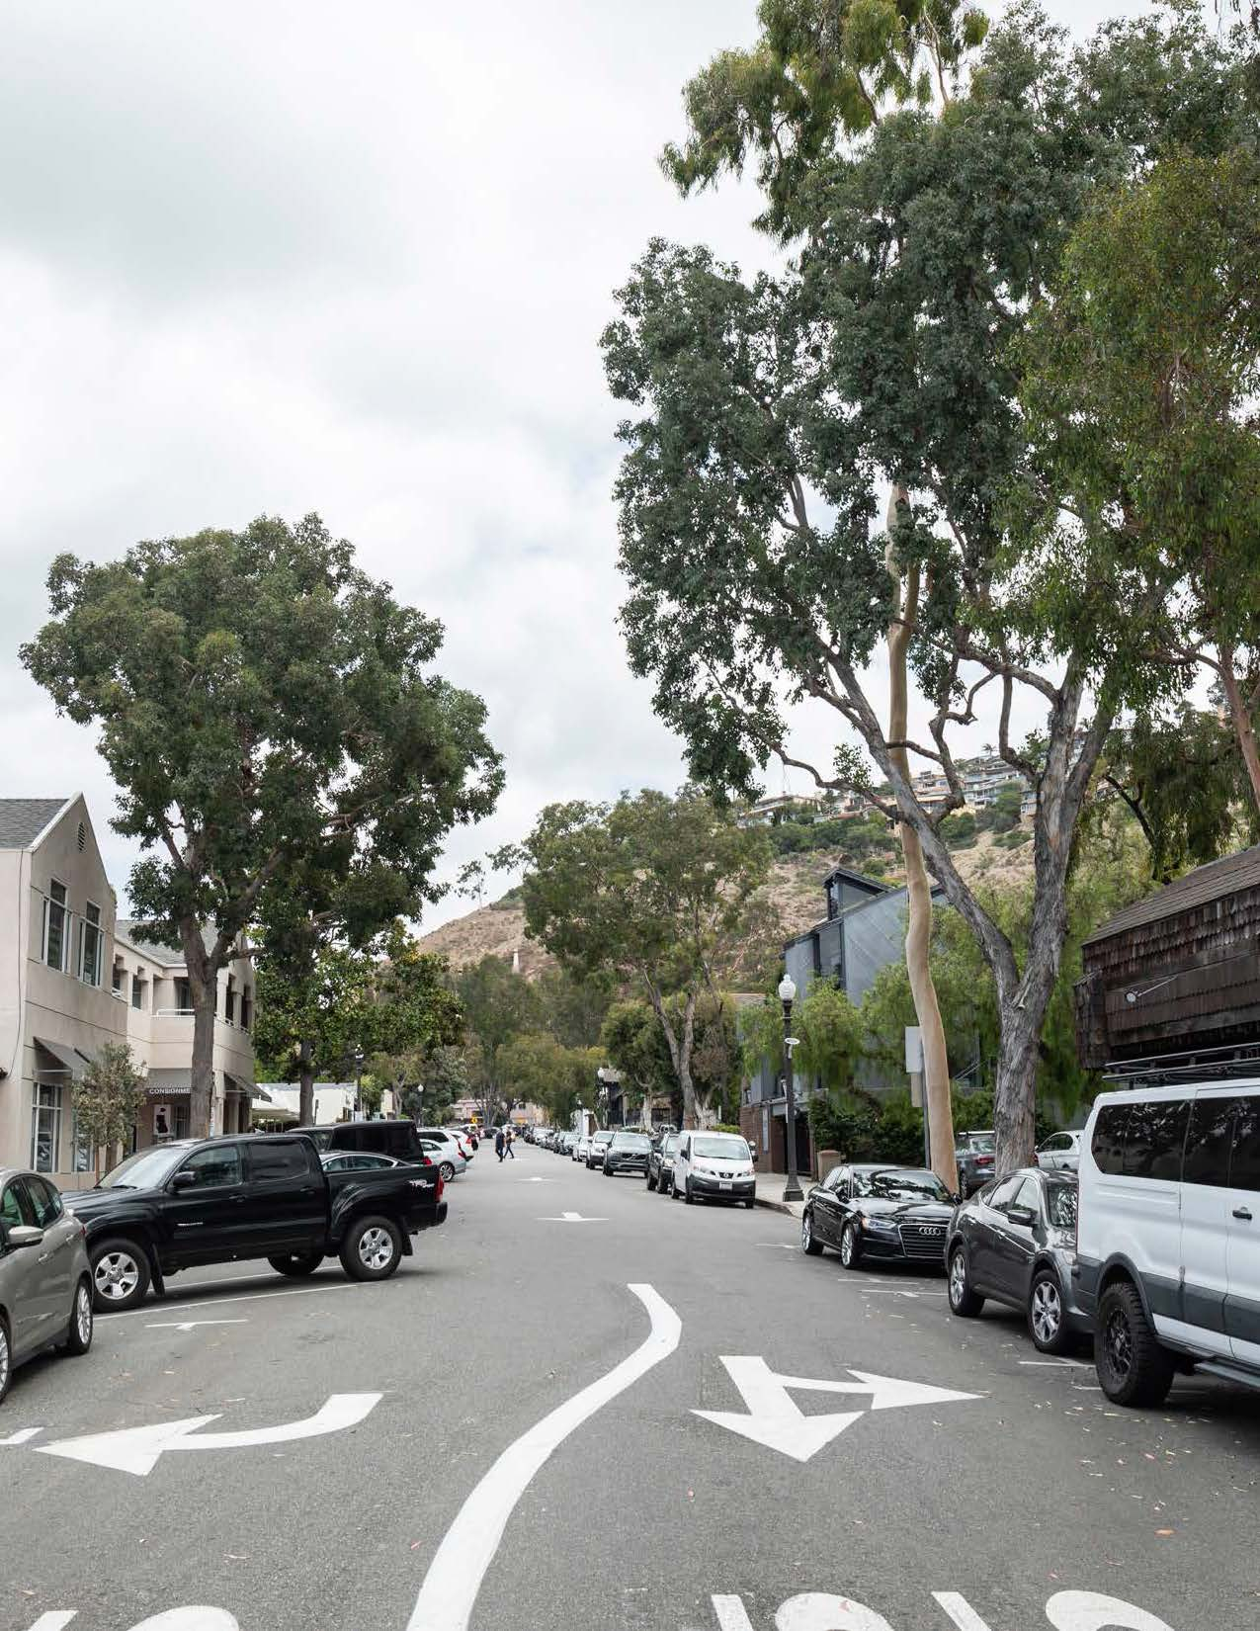
We need a “refreshed street tree palette which serves to reduce the scale of the street and provide shade.”
We already have diverse types of trees that produce shade and beauty. More should be planted without destroying what we have.

Slide 4
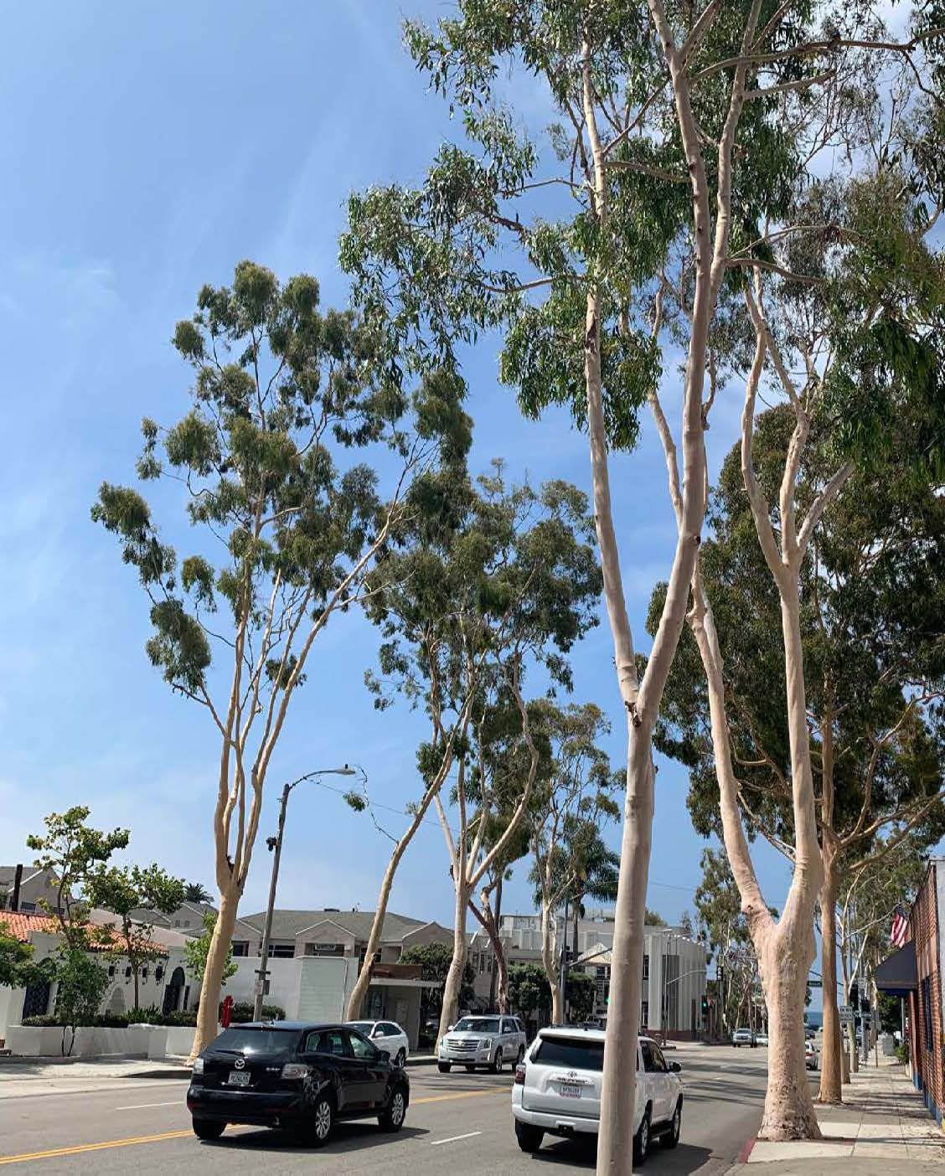
On Broadway Lemon-scented gum trees’ “monolithic character and sparse foliage do not lend themselves to a comfortable, human-scale, and shaded setting.” p. 11, staff report
Dramatic beauty is also important—not all trees have to be “human scale” (small).

Slide 5
Do we value the views to the ocean framed
by the Lemon-scented gums?
Artists do.
Mark Jacobucci

Slide 6
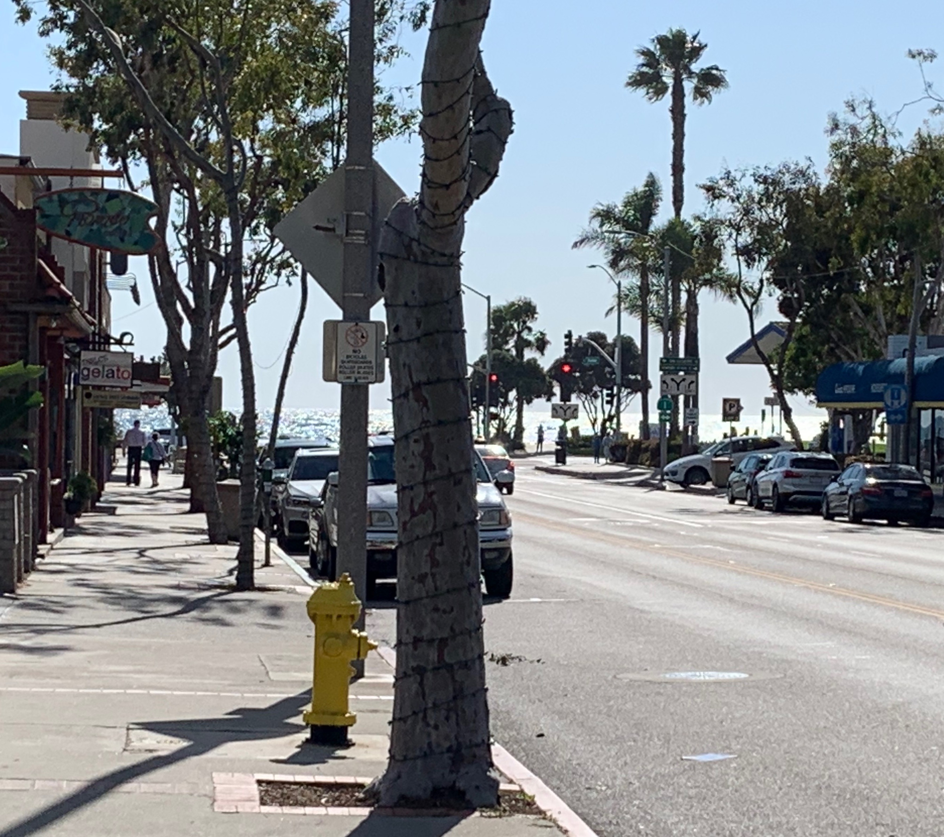
Do we value the views to the ocean framed by the Lemon-scented gums?
Yes, we do.

Slide 7
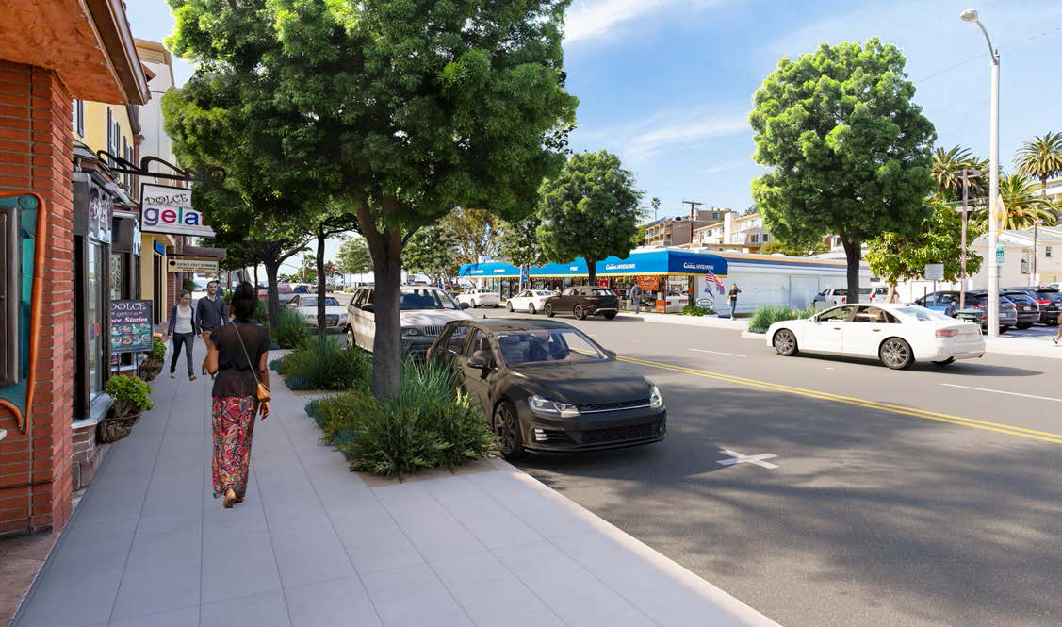
Thick foliage of canopy trees will block views of ocean and store signs—and it will take years for new trees to grow as large as this simulation.

Slide 8
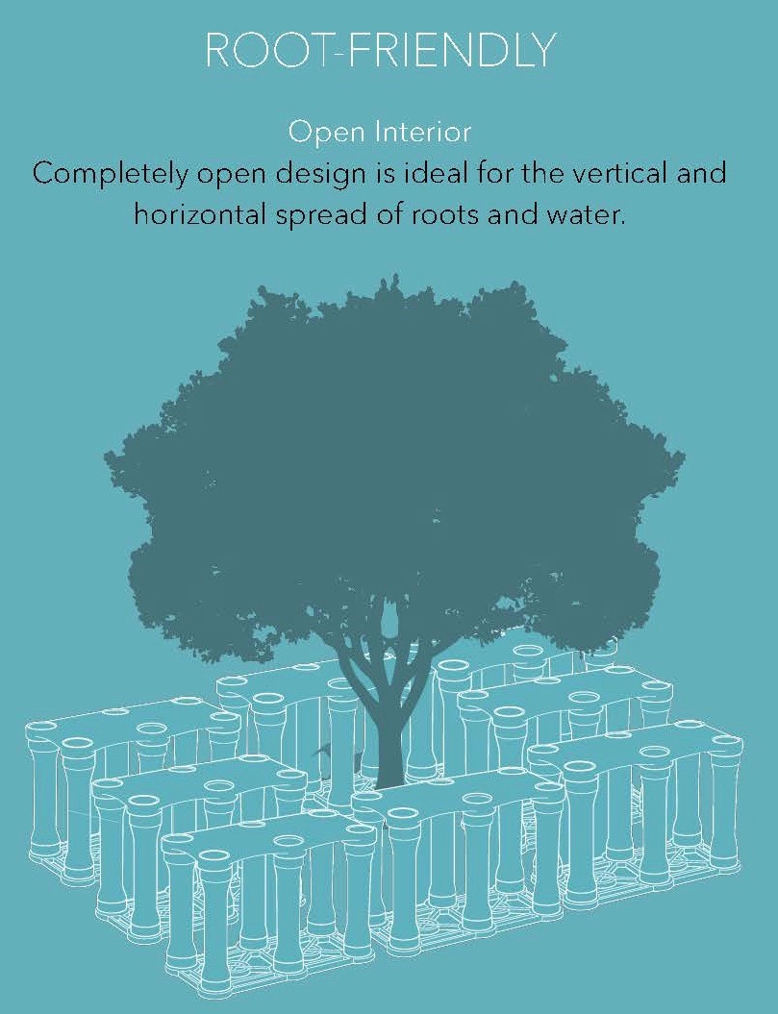
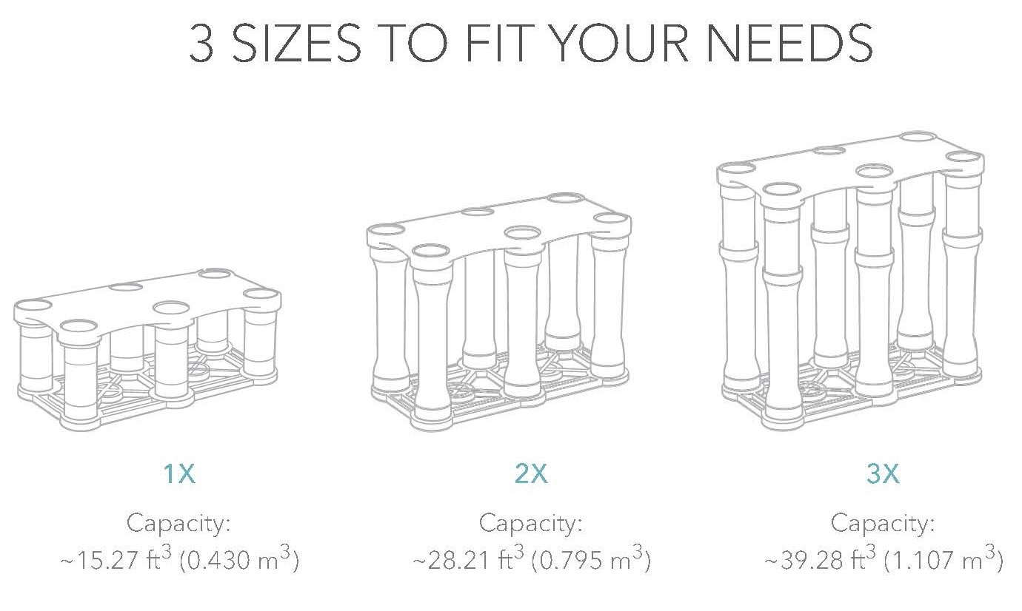
Structural soil cells are what we need?

Slide 9
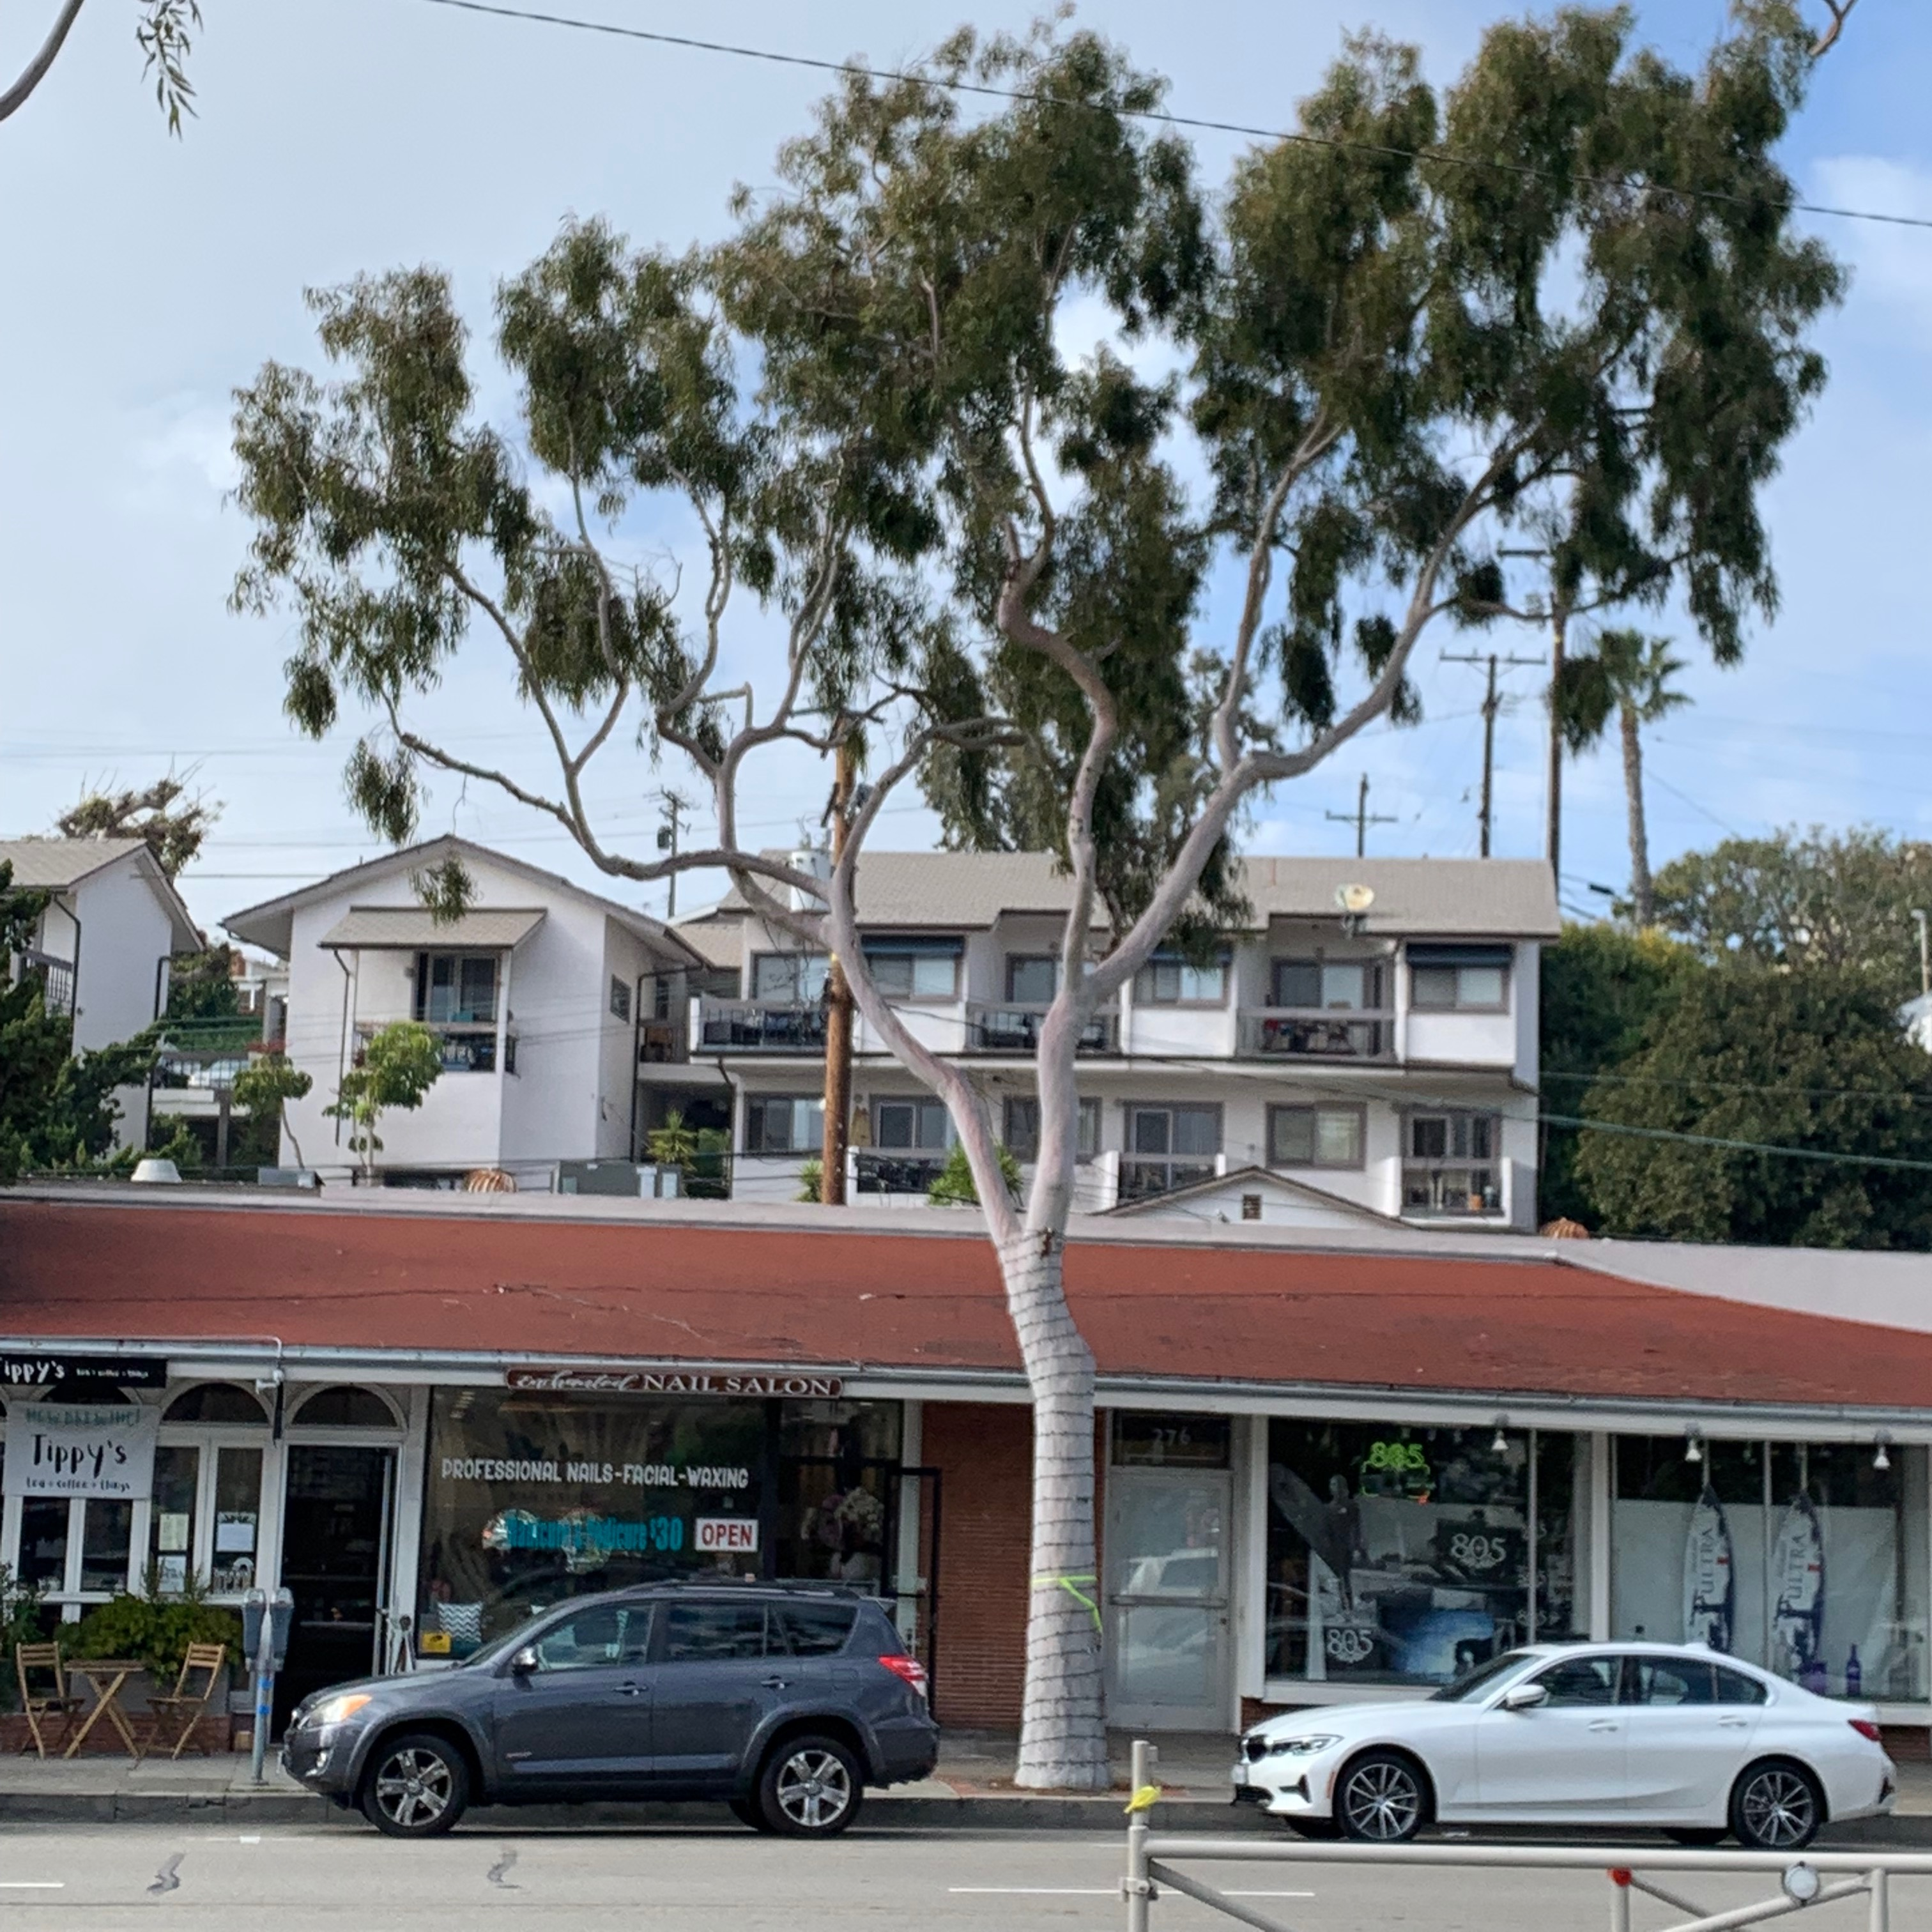
Is installing these worth losing mature trees?

Slide 10
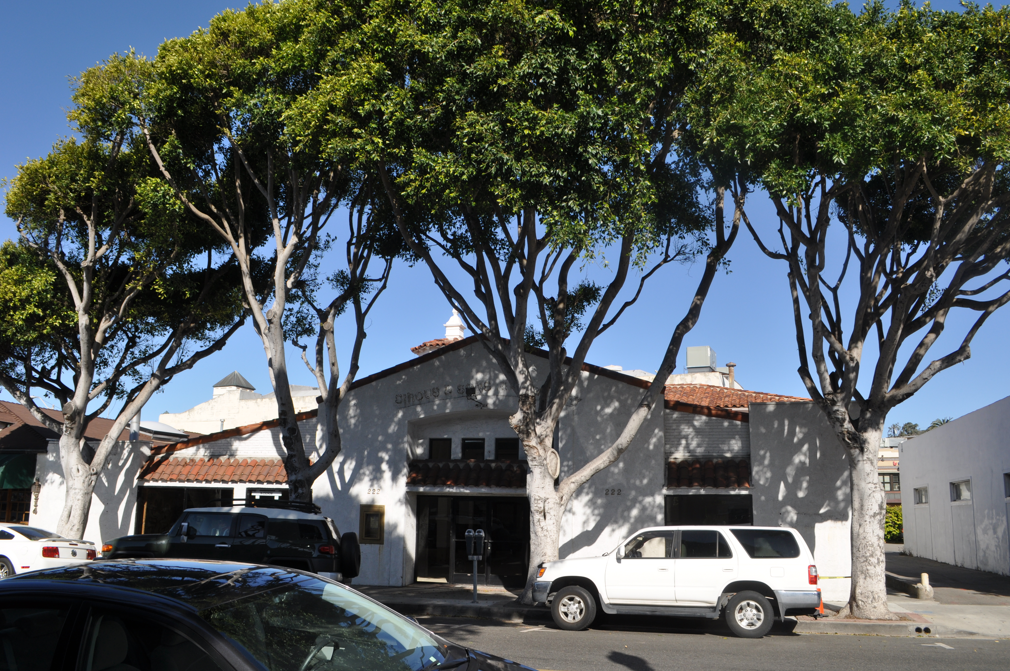
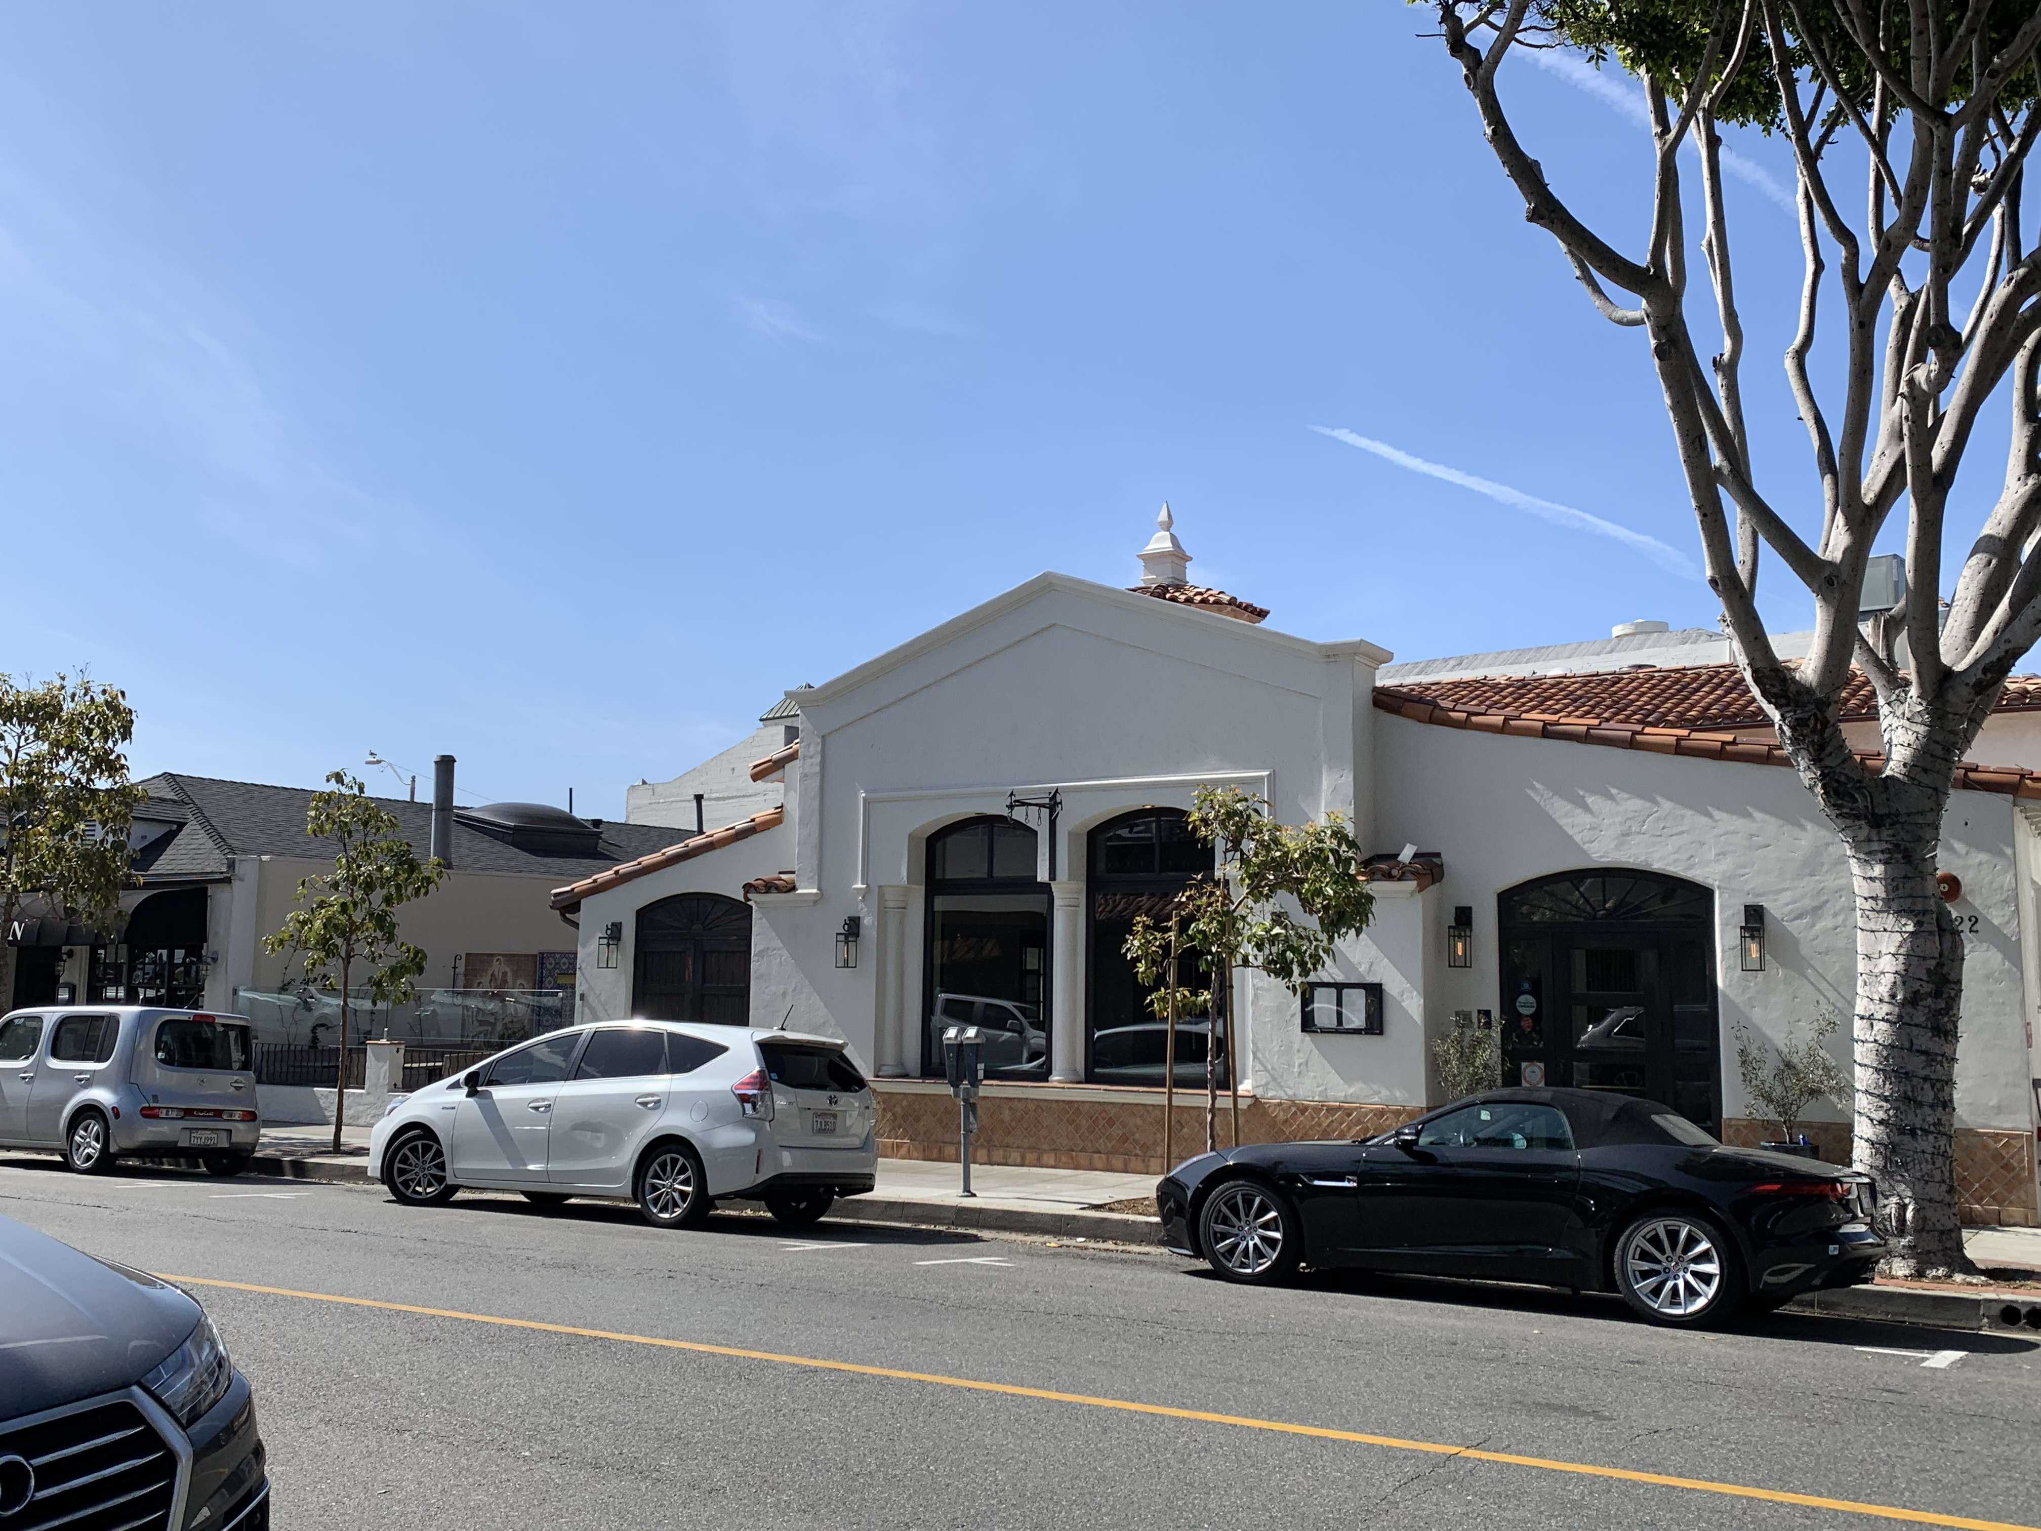
222 Ocean Avenue
222 Ocean Avenue
2013 before tree removal
2020, 7 years after 36” box trees were planted.
Don’t worry, we’ll plant large replacement trees. It will look fine in 5 years.

Slide 11
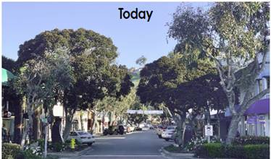
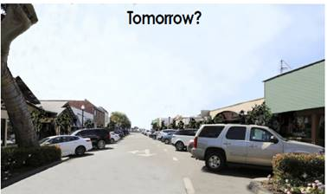
222 Ocean Avenue
222 Ocean Avenue
YES, WE’RE WORRIED
DON’T LET THIS HAPPEN AGAIN.

